Slide 1
Eyetracking Lab Rotation Winter Semester 23-24 Chris Allison
Reading and presenting your paper

Slide 2
Goal
Be able to (efficiently) read and understand papers
Be able to talk about the findings

Slide 3
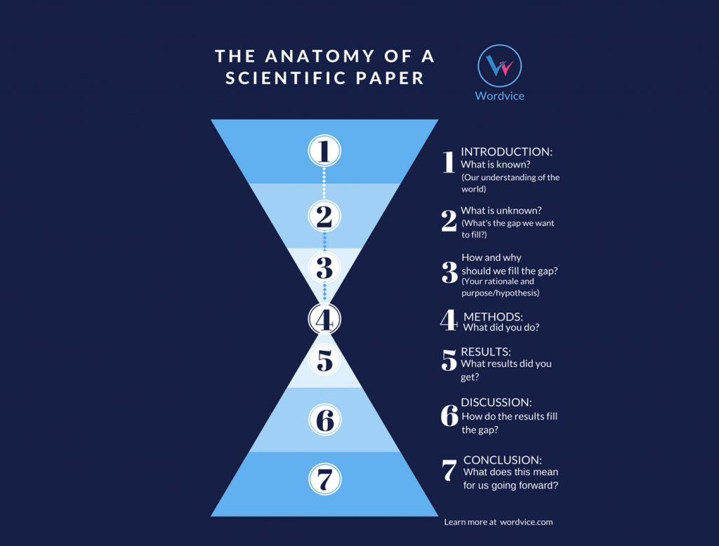

Slide 4
Introduction: Setting the Scene
May or may not contain subsections
Goes from broad topics and gets progressively more specific to the study at hand
Typically ends with a brief overview of the study

Slide 5
Introduction: What to Look For
What are the broad themes this study will deal with?
What is the current state of the related research?
What inspired this study?
What is their research question/hypothesis?

Slide 6
Introduction: Tasks for your Presentation
Make a short outline of the introduction
What are the major topics being discussed in the paper?
“Previous research on x found…”
Give us a brief introduction of the goals, research questions, and hypotheses
“The authors wanted to see if comprehenders consider perspective at early stages of predictions. If they do, they expected… If they don’t, they expected…”

Slide 7
Methods: The Details
This is where the specifics of the study are defined
Contains information on the following:
Participants
Design
Materials/Stimuli
Tasks
Procedure

Slide 8
Methods: What to Look for
What is the participant sample like?
Is this normal for similar studies? What are the strengths/weaknesses of this population?
WEIRD?
What kind of paradigms and manipulations were used?
How many trials were there?

Slide 9
Methods: Tasks for your Presentation
Tell us what they actually did!
Define the participant population
Size? Age? Language(s)?
How did they use the VWP?
Trials? Manipulations? Type of prediction? Give us an example sentence
Speech rate!
Other measures?

Slide 10
Results: The Fruits of your Labor
Data Analysis
Statistics
Visualizations

Slide 11
Results: What to Look for
Understand the graphs and tables
Typically, the highest value information of a paper is going to be in the graphs
What kind of data analysis method was used
Did they find support for their hypotheses?

Slide 12
Results: Tasks for your Presentation
Tell us what they found!
Show us the time course graph(s) and explain it/them
What type of analysis did they use?
Findings?

Slide 13
Discussion: Putting Things in Perspective
Interpretation of Results
Is this what we expected to find?
Why does this result matter?
Are they consistent with the previous research?
How does this fit in with the current research?
Advances some knowledge? Refutes some findings?
Limitations

Slide 14
Discussion: What to Look for
What are the findings consistent or inconsistent with?
How does this extend the current research?
What are the implications for future research?

Slide 15
Discussion: Tasks for your Presentation
Give an example of how this research relates to previous research
Give us a conclusion

Slide 16
Recap: Make Sure to at Least Include These
An outline of the relevant topics covered in the Introduction section
The goals, research question, or motivation of the study
Information on the participants
Information on the VWP stimuli (auditory and visual)
Information on the type of analysis used
Results of the analysis (time course graph!)
How these findings relate to established research
Conclusions
Ask some sort of question about something you don’t understand in the study

